Slide 1
Finishing the Return/Refund and Amount Owed
New Jersey Slides
Tax Year 2018

Slide 2
Finishing the NJ Return
Most information on NJ return is already filled in by the time you finish federal return
Most fields are automatically calculated from Federal entries
Sometimes you must signify special NJ tax treatment by using fields on Federal screens
For example, the amount of interest on US Savings Bonds to be subtracted from state income is entered on federal interest screen

Slide 3
Entries in the TaxSlayer State Section
In certain cases, you should have captured specific information on the NJ Checklist as you were entering data in Federal section so that you would not forget to enter necessary adjustments now that you are up to State section
For example, property taxes, military pension
There are a few situations which are unique to NJ so they will also require entry in the TaxSlayer State section
Use tax due on out-of-state purchases
Rent
NJ refund to apply to next year’s return
NJ estimated payment vouchers

Slide 4
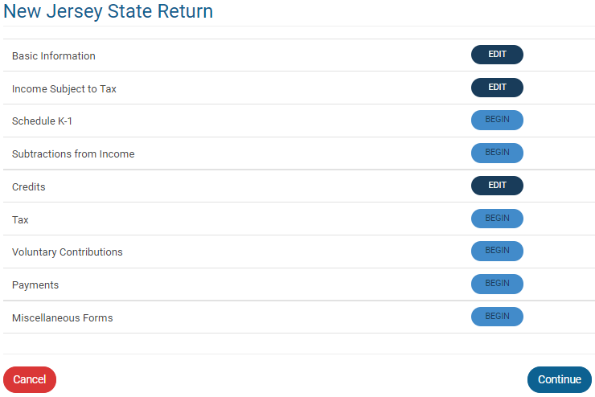
TS – State Section Menu

Slide 5
TS – Basic Information
TaxSlayer started the NJ return after four questions were answered in the Basic Section. These questions are:
Municipality code
Dependent health insurance coverage
Gubernatorial elections fund
NJ PINs
Depending on circumstances, additional basic information may be needed

Slide 6
TS - Basic Information - Additional Inputs That May Be Needed
May need to answer some additional Basic Information questions, depending on the taxpayer’s circumstances:
Disabled taxpayer/spouse (for additional exemption)
Full-time college students < age 22 (for additional exemption)
Request for NJ tax forms to be mailed next year
Federal/NJ extensions filed
Need to attach death certificate for deceased person on return
Part-year NJ resident
Information to answer these questions should have been captured in the NJ Checklist Basic Information section as you progressed through the Interview and previous TaxSlayer sections

Slide 7
TS – Income Subject to Tax
Certain types of income are handled differently in NJ than on the Federal return and, therefore, may need to be adjusted on the NJ 1040
Taxable scholarships – taxable amount may be different for NJ
Medicaid waiver payments on W-2
Military pensions - not taxable for NJ
Disability pensions - not taxable for those < 65 for NJ
Taxable and excludable portions of pensions - reported separately on NJ 1040 Lines 20a and 20b
NJ taxable amount of a retirement distribution may be different than Federal taxable amount (e.g. – NJ contributory pensions, 403b/457b/TSPs, IRA withdrawals, distributions eligible for NJ 3-year rule)
Public safety officer insurance premiums – up to $3,000 excluded from Federal pension, but included in NJ taxable pens

Slide 8
TS – Income Subject to Tax
Certain types of Other Income on Federal 1040 are handled differently on NJ 1040
Cancellation of credit card debt - not taxable in NJ (now automatically handled by TaxSlayer)
PTR recovery - not taxable in NJ
Homestead Benefit recovery - not taxable in NJ
Gambling winnings are netted against losses and the net is reported on NJ 1040 Line 24, not as Other Income
Since the Federal Other Income amounts on 1040 flow through to NJ Other Income Line 26, may need to add or subtract from Line 26 to reflect the different tax treatment

Slide 9
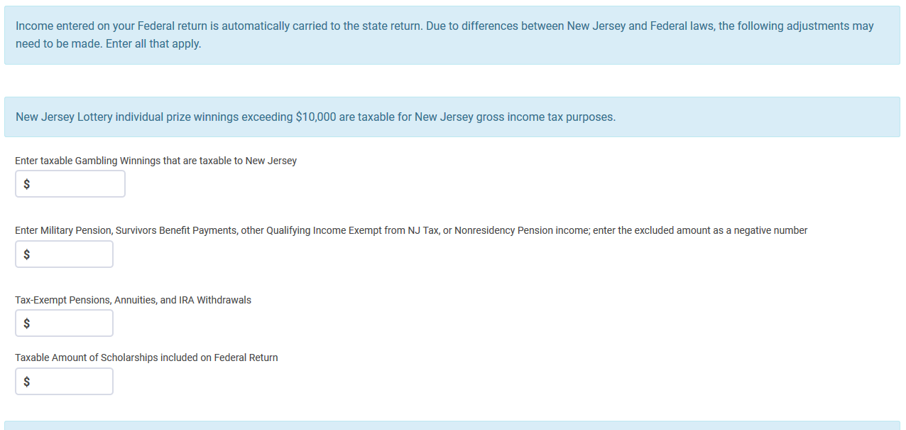
TS – Income Subject to Tax
Adjustment for gambling winnings
Adjustment for military pension
Adjustment for tax-exempt pensions, annuities and IRA
Adjustment for scholarships

Slide 10
TS – Subtractions from Income
Adjustments to capital gains for securities that are exempt from NJ tax
Adjustment for capital gains for securities exempt from NJ tax

Slide 11
TS – Subtractions from Income
Medical insurance premiums that are pre-tax for Federal are considered after-tax for NJ
Cannot be claimed as medical expense for Federal, so not included in medical expenses that flow through to NJ 1040
Can be claimed as medical expense for NJ, so must be added to medical expenses already on NJ 1040 Line 31
Adjustment for pre-tax medical premiums

Slide 12
TS – Subtractions from Income
Second question about disability on NJ Checklist
First disability question in Basic Information section is used to determine eligibility for additional exemption
Second question is used to determine if taxpayer is eligible for NJ pension exclusion (even if under age 62)
Answers to the two disability questions could be different since pension exclusion requires disability as per SSA guidelines

Slide 13
TS – Subtractions from Income
Second question on Disability to determine eligibility for Pension Exclusion

Slide 14
TS – NJ Credits
Credits available through NJ
Property tax credit/deduction (details covered in Itemized Deductions module)
Answer question as to whether taxpayer meets property tax eligibility requirements (if answer is NO, taxpayer will not receive credit)
Enter appropriate property taxes on principal residence and/or 18% of rent
Use scratch pad on TaxPrep4Free.org to document calculation
Answer question as to whether taxpayer was a homeowner in 2016
If homeowner, must also enter block and lot data

Slide 15
TS – NJ Credits
Credits available through NJ
Credit for taxes paid to another state
See Special Topics documents on TaxPrep4Free.org Preparer page
Sheltered workshop tax credit
Out of Scope

Slide 16
Use Tax Due on Out-of-State Purchases – NJ 1040 Line 50
From NJ1040 Instructions:
“When you purchase taxable items or services to be used in New Jersey but do not pay sales tax, you owe use tax. This commonly occurs when purchases are made on the Internet, by phone or mail order, or outside the State from sellers who do not collect New Jersey sales tax. The New Jersey use tax rate is the same as the sales tax rate. If you paid sales tax to another state at a rate less than 6.625% on a purchase that would have been taxed in New Jersey, you owe use tax based on the difference between the two rates. …”

Slide 17
Use Tax Due on Out-of-State Purchases – NJ 1040 Line 50
For total of items/services costing < $1,000 each
With receipts, can use 6.625% of purchase amount(s) (minus any sales tax paid) OR
Can use Estimated Use Tax Worksheet to estimate Use Tax due based on income
For each item/service costing $1,000 or more
Must calculate exact Use Tax due
Use Tax due for these items is in addition to total for items/services costing < $1,000 each
If sales tax < 6.625% was paid, must pay difference
See Worksheet H in NJ 1040 Instructions for more detail
Calculate amount due using NJ Use Tax Due link on TaxPrep4Free.org Preparer page
Enter in State section \ Edit \ Enter Myself \ Tax

Slide 18
Use Tax Due on Out-of-State Purchases – NJ 1040 Line 50
Enter Use Tax Due

Slide 19
TS – NJ Refund Options
State return has the same four options as federal
Paper return
E-file paper check
Paper return with direct deposit
E-file direct deposit

Slide 20
NJ Refunds Applied to Next Year’s Taxes
Can choose to apply all or part of current year’s NJ refund to next year’s NJ taxes
Enter in State section \ Edit \ Enter Myself \ Payments TaxSlayer will populate amount to be applied to next year on and re-calculate amount of refund taxpayer will receive this year

Slide 21
Amount Owed: NJ Payment Options
Check or money order – send NJ-1040V voucher with payment
Electronic funds transfer (direct debit)
File return immediately & specify date for transfer
Credit card (additional fee)

Slide 22
Tax Penalty for Underpayment of NJ Taxes
TaxSlayer will issue a warning during e-file process if taxpayer may owe penalty (i.e. - owes an amount greater than $400 for NJ
Penalty is Out of Scope, so choose option to file without including penalty
Alert taxpayer that they may receive a letter from NJ
Make a note that alert was given to taxpayer in Intake/Interview sheet notes section and in TaxSlayer notes

Slide 23
Conditions When Estimated Tax Payments are Required for Next Year
Taxpayer tax liability in current year more than what was withheld and/or paid in advance AND
Taxpayer expects to owe for next year more than $400 to NJ after subtracting tax withheld & tax credits from tax liability AND
Taxpayer expects next year’s tax withheld to be less than:
90% of the tax liability on next year’s return, or
100% of tax liability shown on current year’s return
Estimated taxes required if taxpayer is self-employed

